Slide 1

Water Point Commitee (W.P.C)
This user guide will help you navigate to the mWater console: CPE Monthly Report. And display the features available.

Slide 2
How to access the console?
Access the mWater portal.
Access the HANWASH portal.

Slide 3
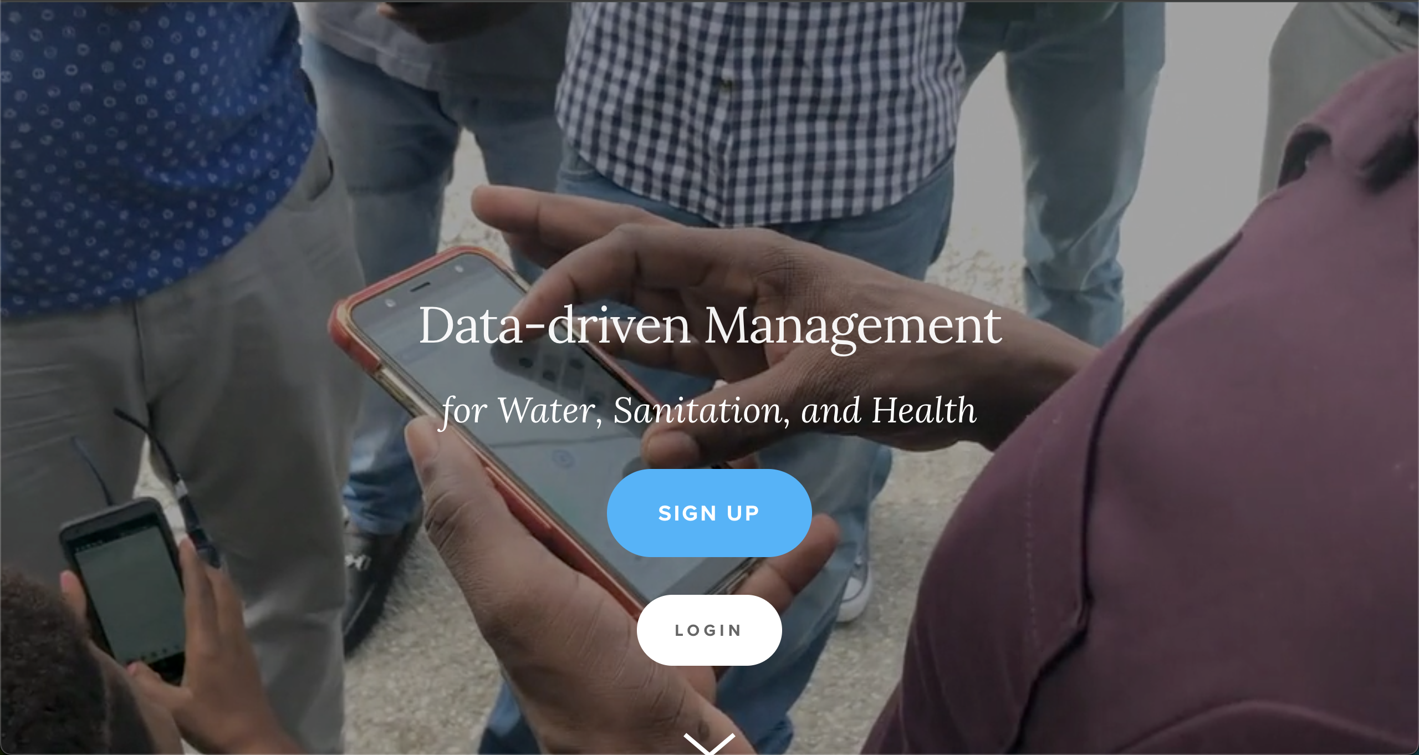
Mwater Home
URL LINK : https://www.mwater.co

Slide 4
Authenication PRocess
Click on the Login button.

Slide 5
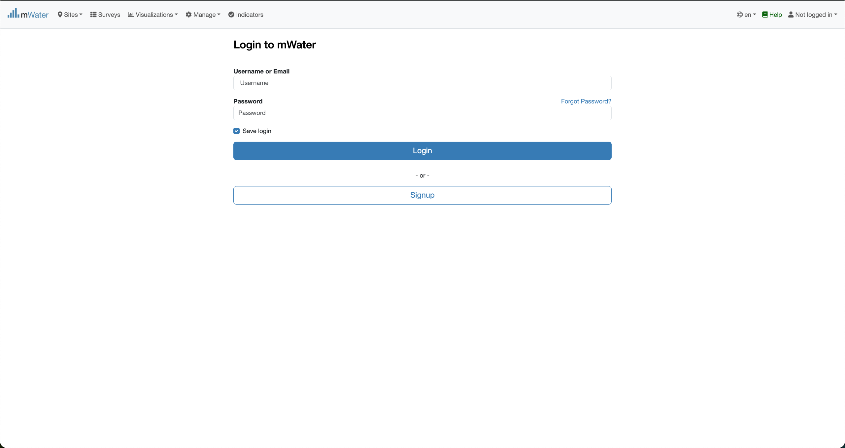
Authentication PRocess
You are not logged in.
Fill with your credentials and click on the log button.

Slide 6
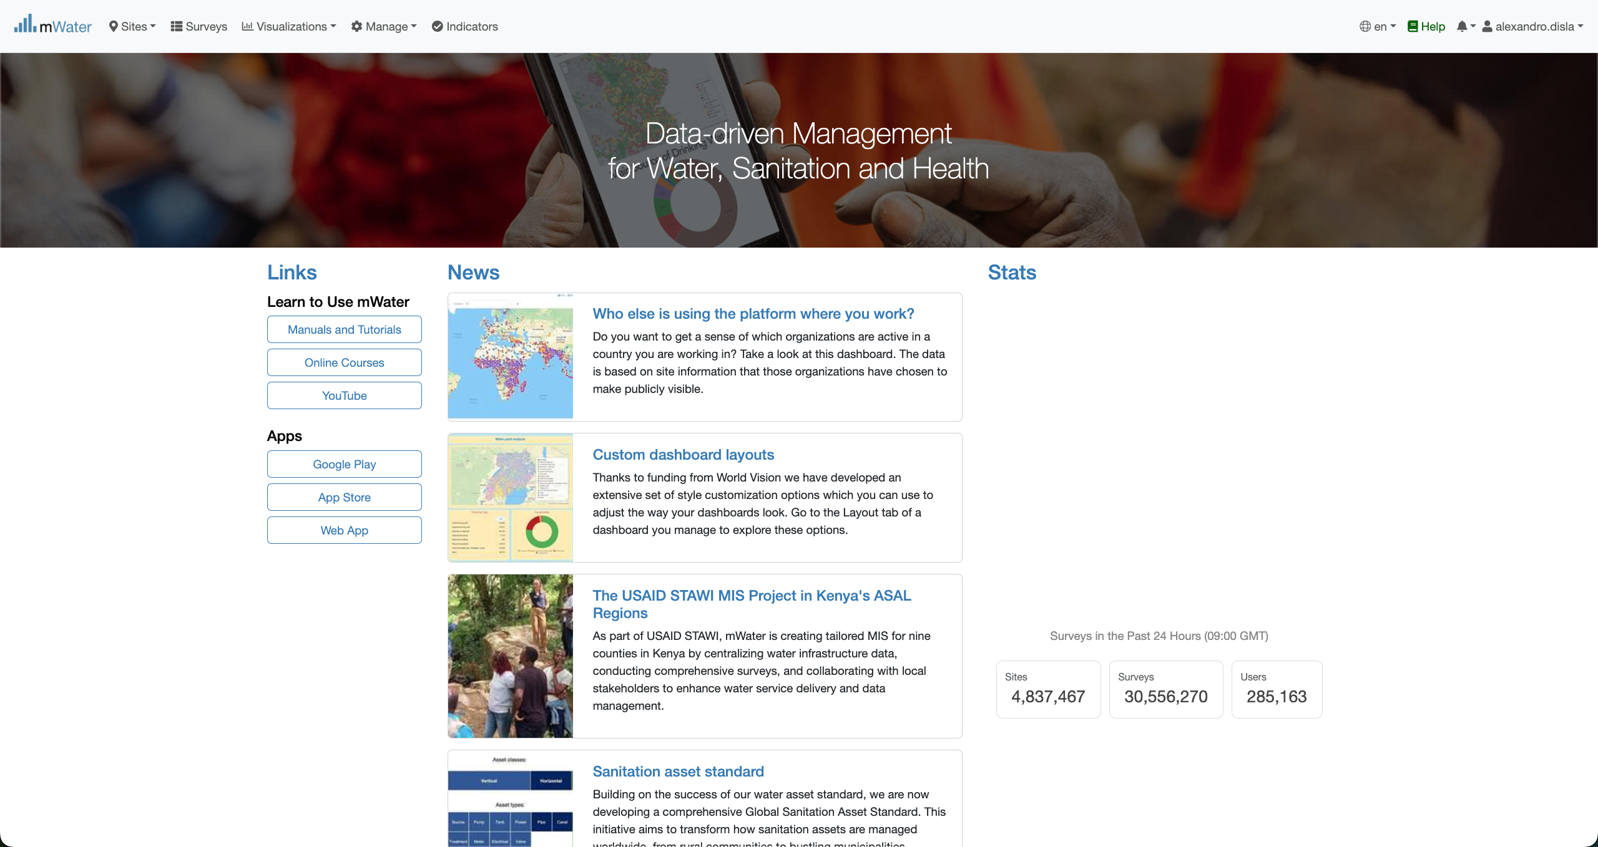
Mwater Home page Portal
You have successfully logged in.

Slide 7
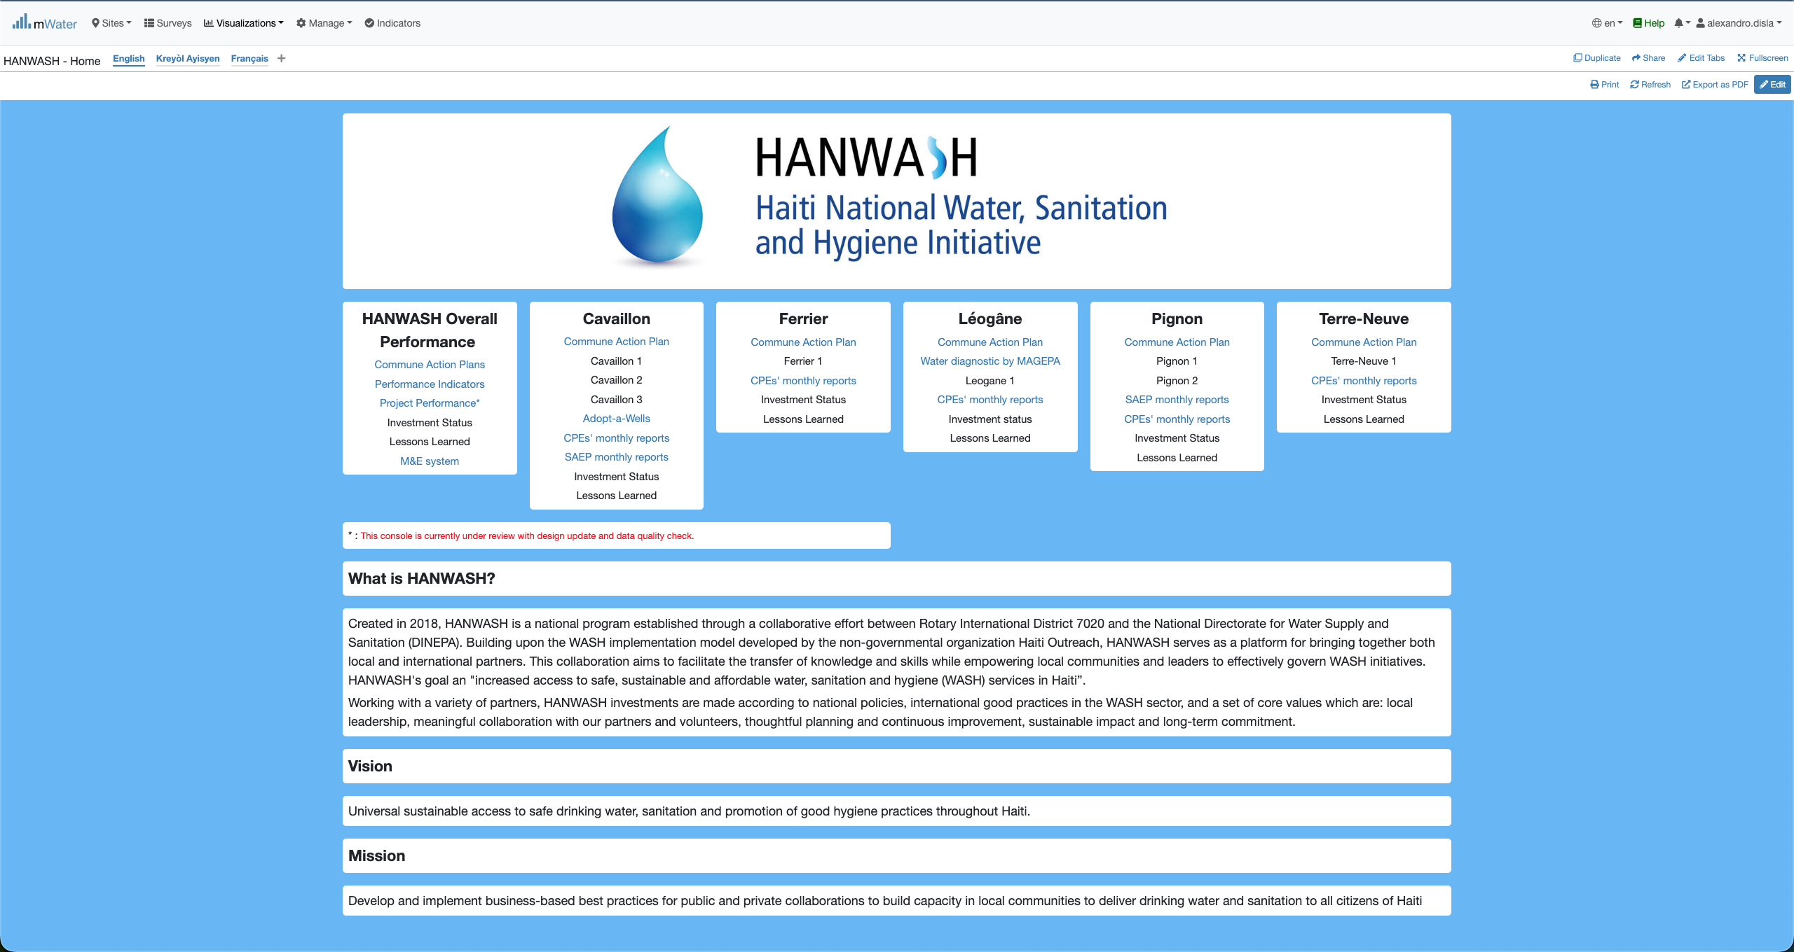
Hanwash HOME
After you have been logged in mWater. Please use this link in your browser to access the HANWASH HOME CONSOLE, quickly.
URL LINK : http://go.mwater.co/hanwash

Slide 8
Access the CPE CONSOLES
Please select the CPE Monthly reports, highlighted by their respective commune. The text in blue are clickable links

Slide 9
Console Overview
We have two page in the console. Please select the version of your pleasing.
1. CPE Reports (English Version)
2. Rapport CPE (French version)
Please stay on the CPE reports page.

Slide 10
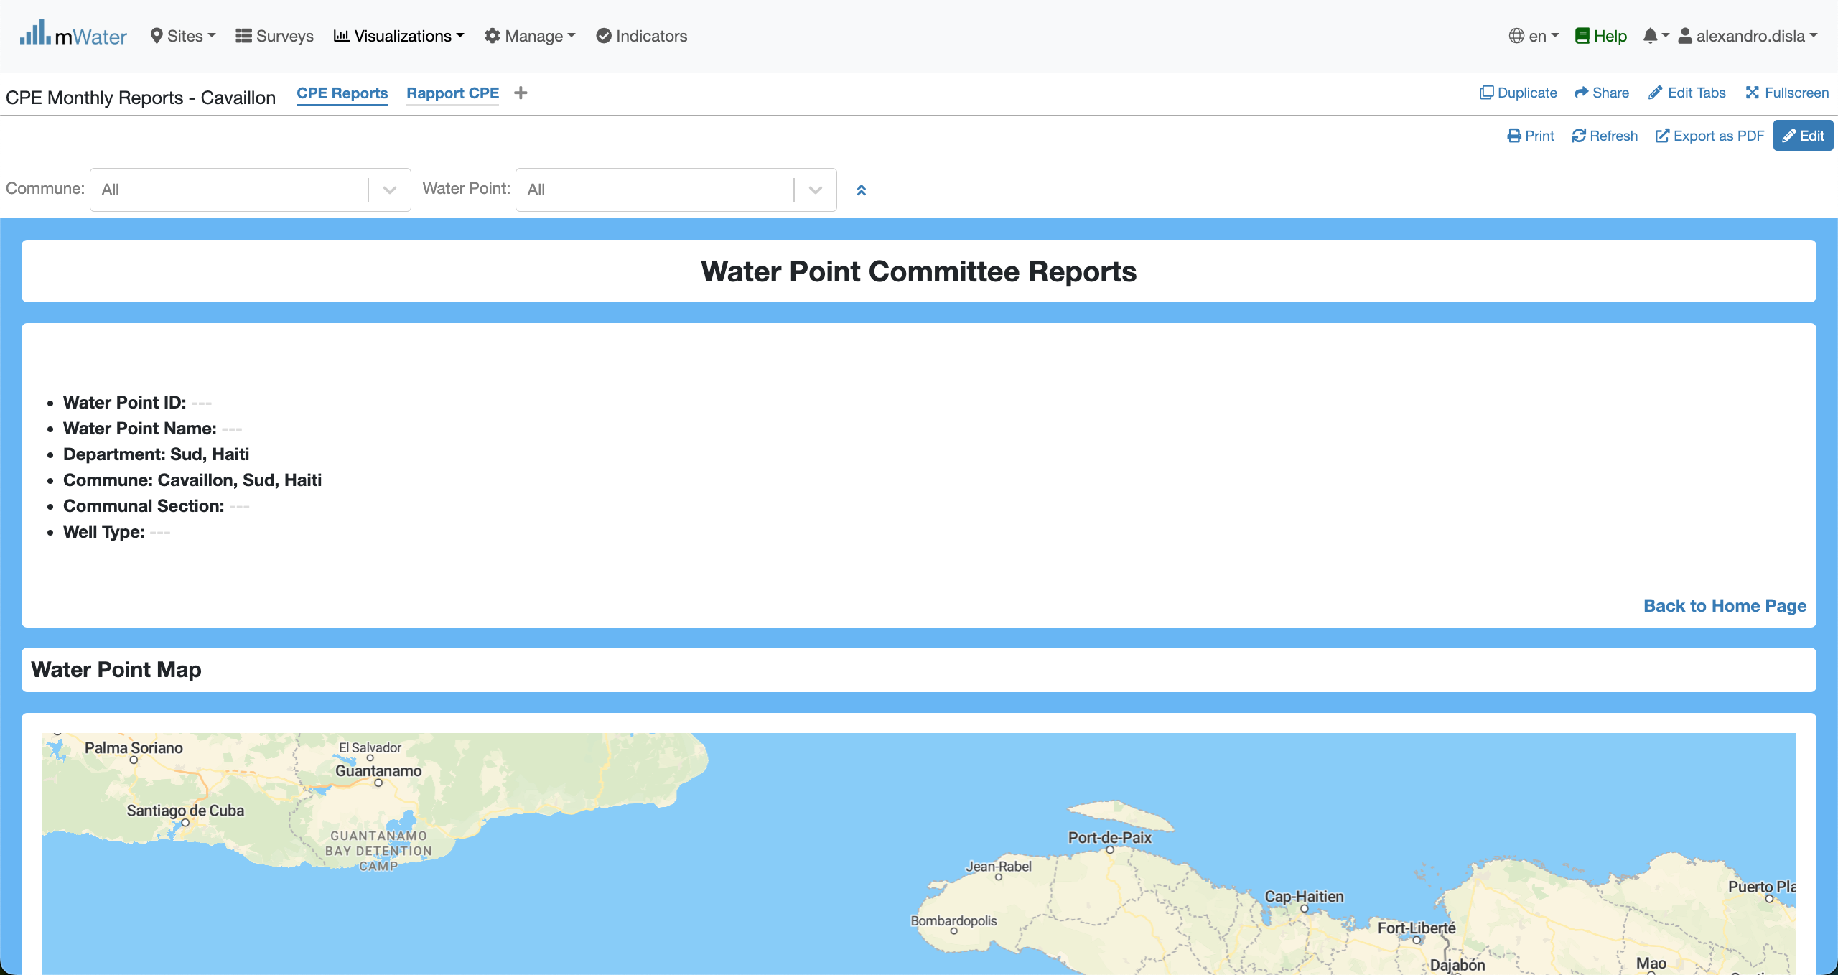
Console Overview
Please make sure that you are on the CPE Reports.
This will bring you back to HANWASH Home.

Slide 11
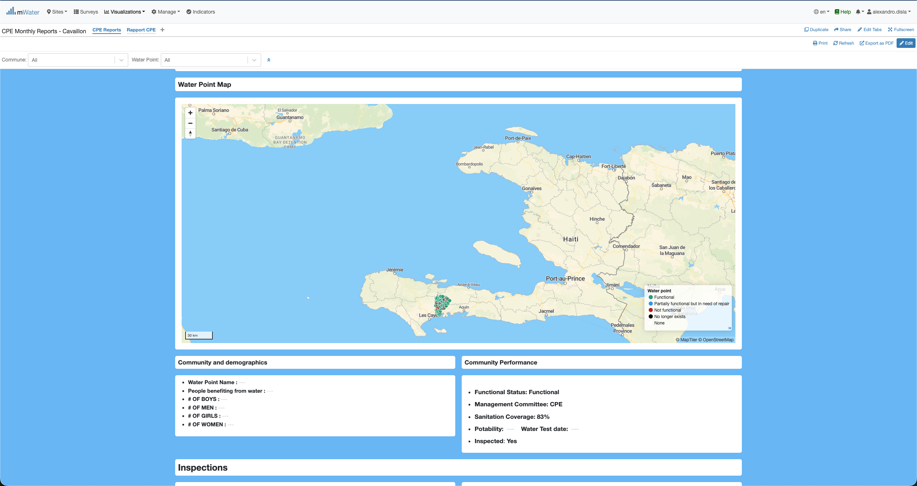
Console Overview

Slide 12
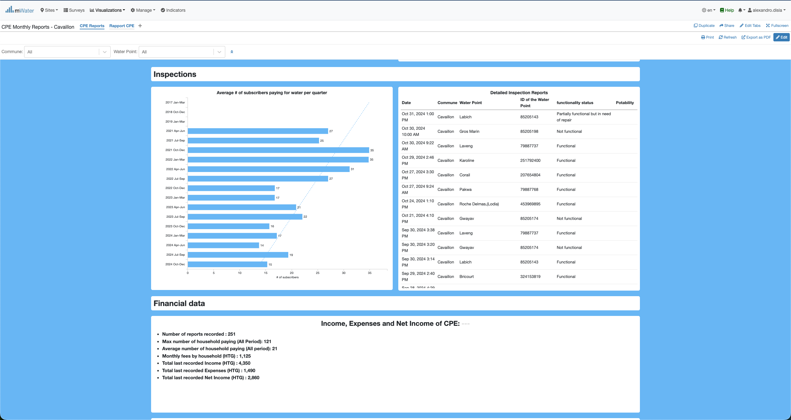
Console overview

Slide 13
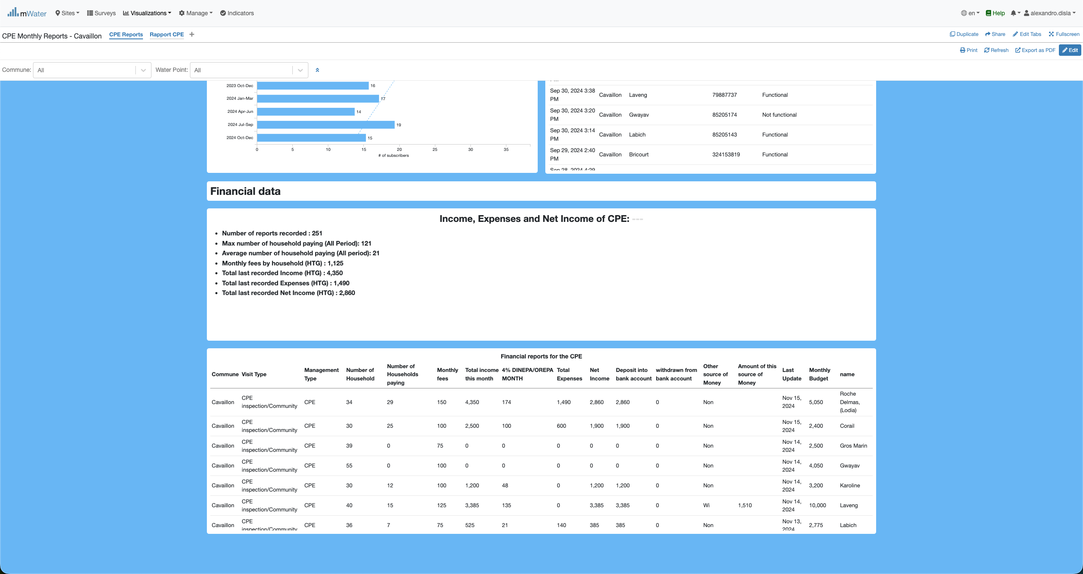
Console overview

Slide 14
Functionalities
What are functionalities available?

Slide 15
CPE REPORTS
CPE Reports:
Header Section
Map Section
Community demographics & performance Section
Inspections Section
Financial Section

Slide 16
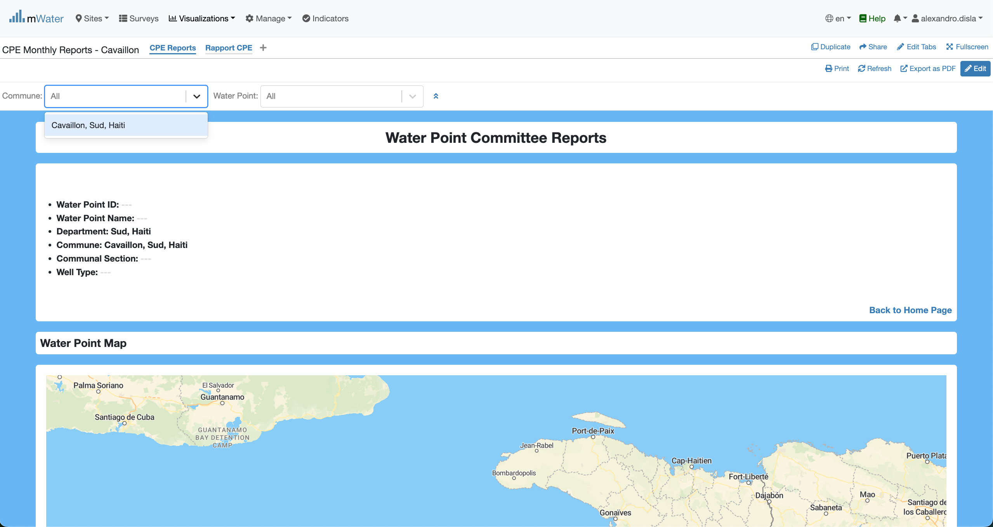
Header & QuickFilters
By design this console is fixed for the commune of Cavaillon.

Slide 17
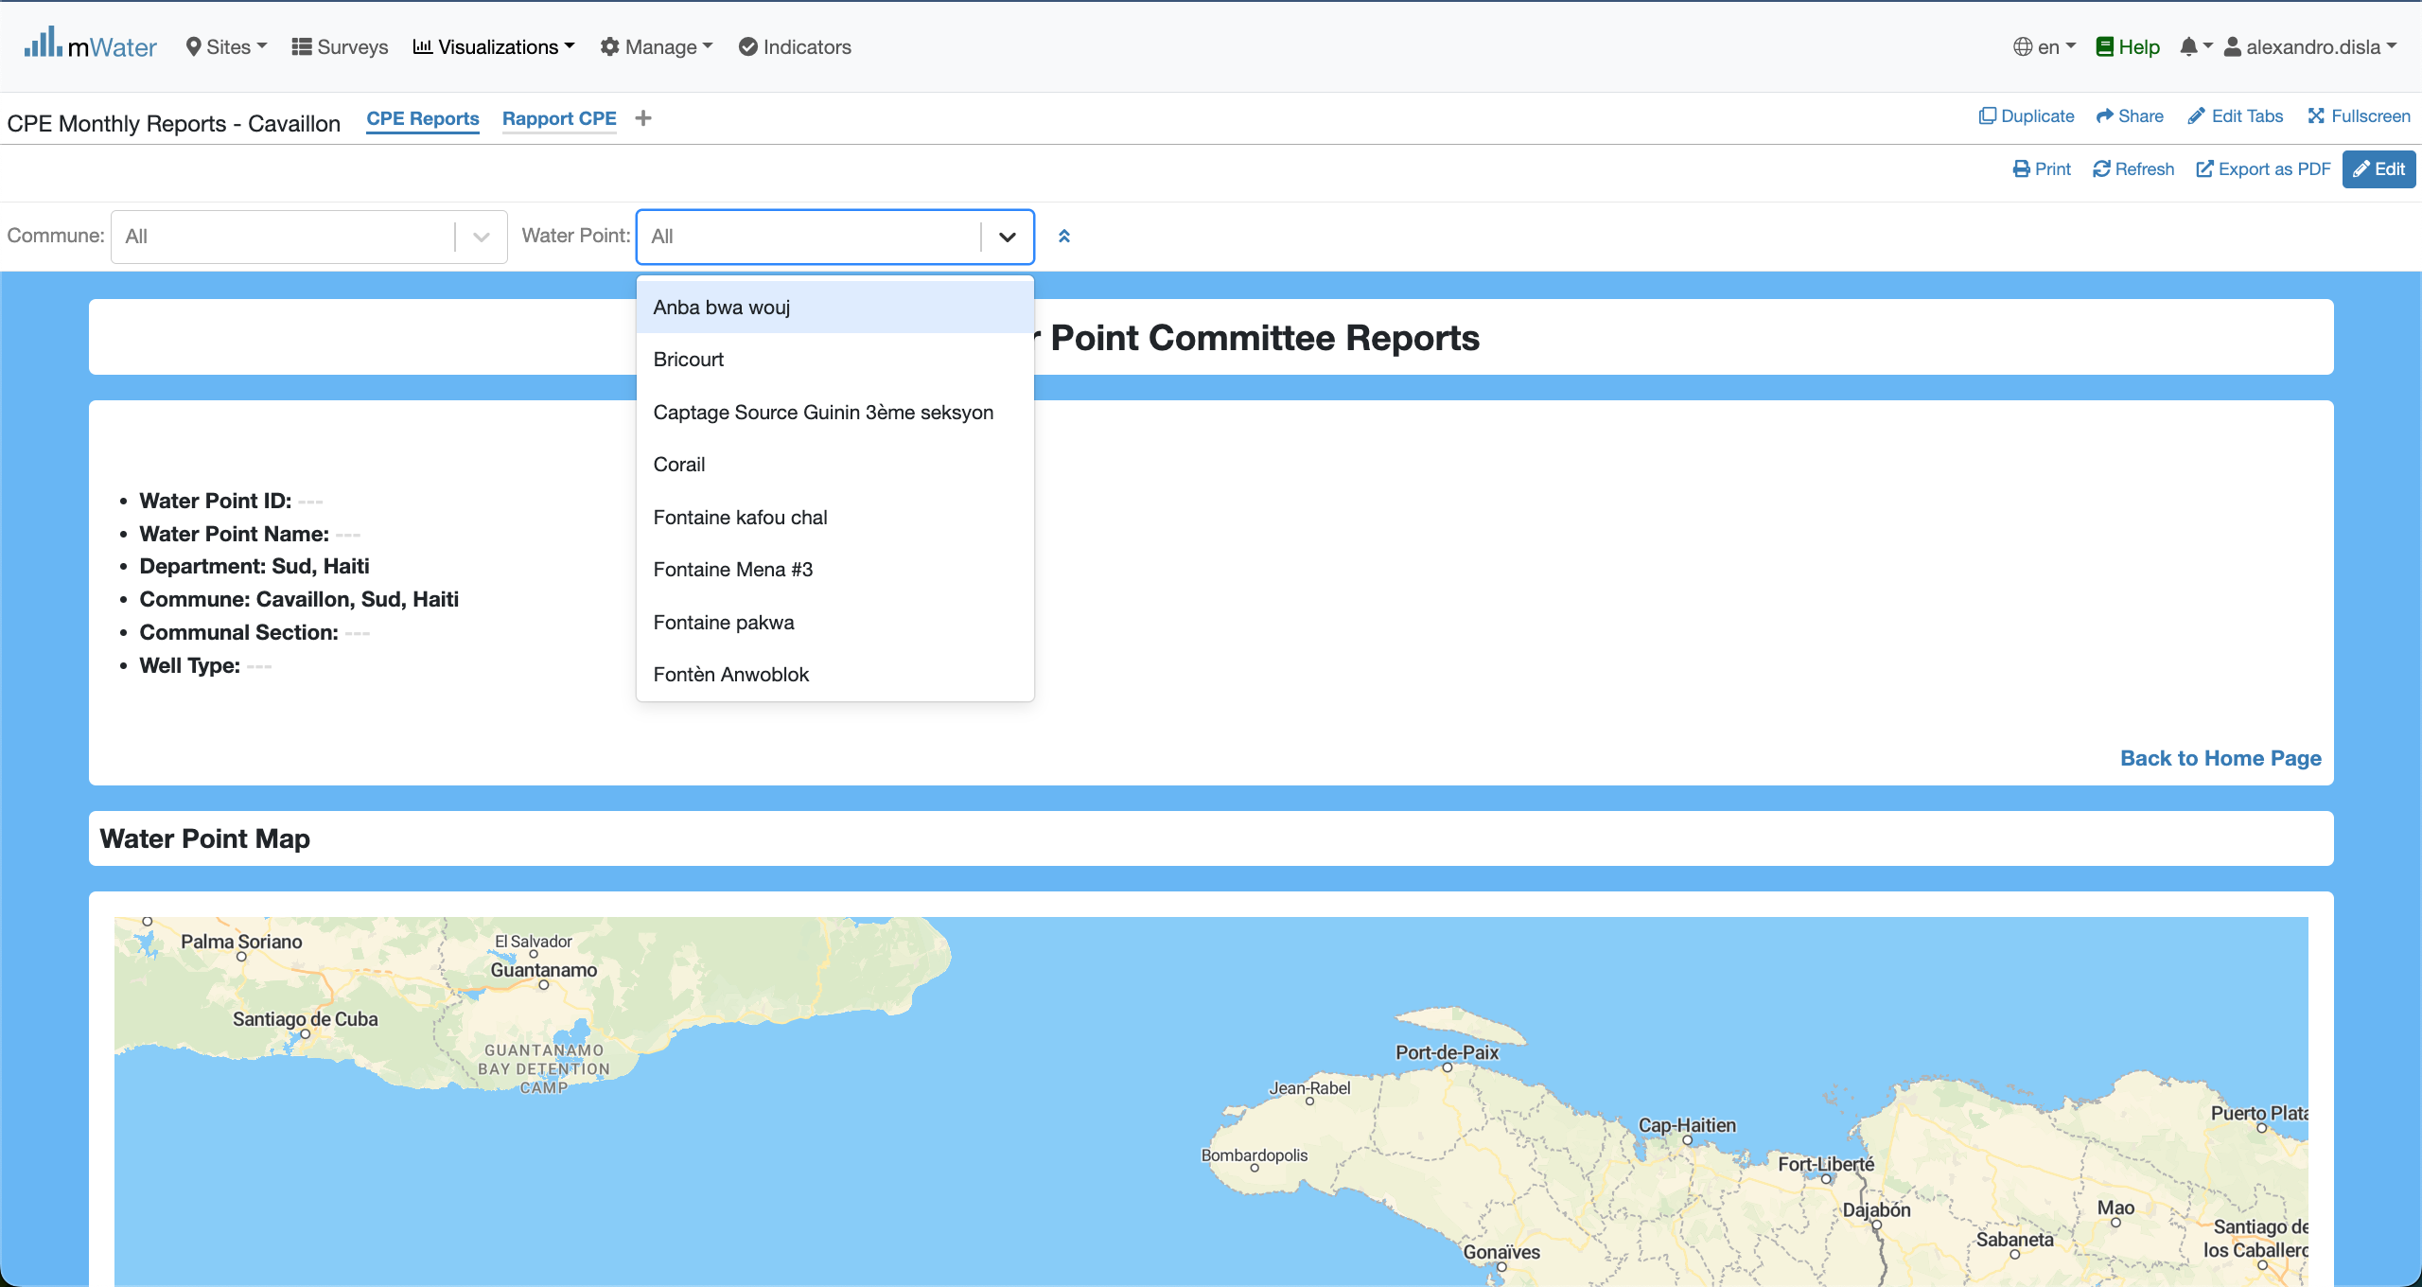
Header & QuickFilters
The water quick filter will display the name of the water points registered.

Slide 18
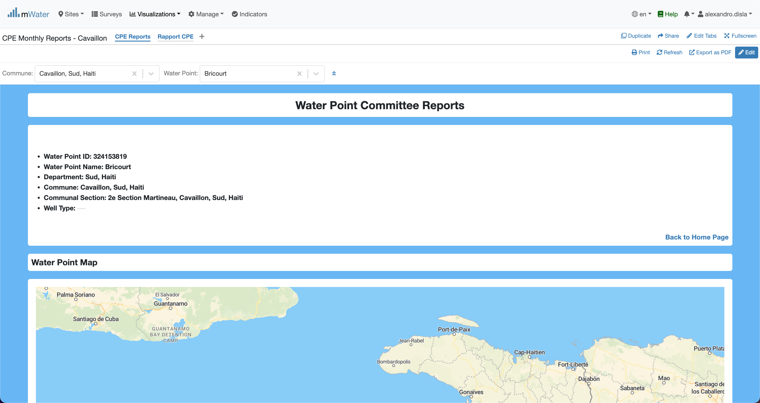
Display data in the console
With the quick filter active, the data will fill each section of the console. The header section display the common general information about the Water point.

Slide 19
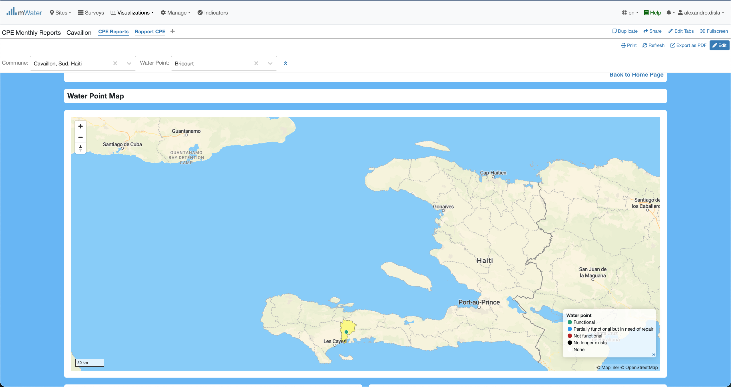
The MAP section
The Water Point is displayed in the map. The color of the water point will be rendered given the functionality status. And you can see the colored area of the commune.
You can click the water point. A modal will pop up with detailed information.

Slide 20
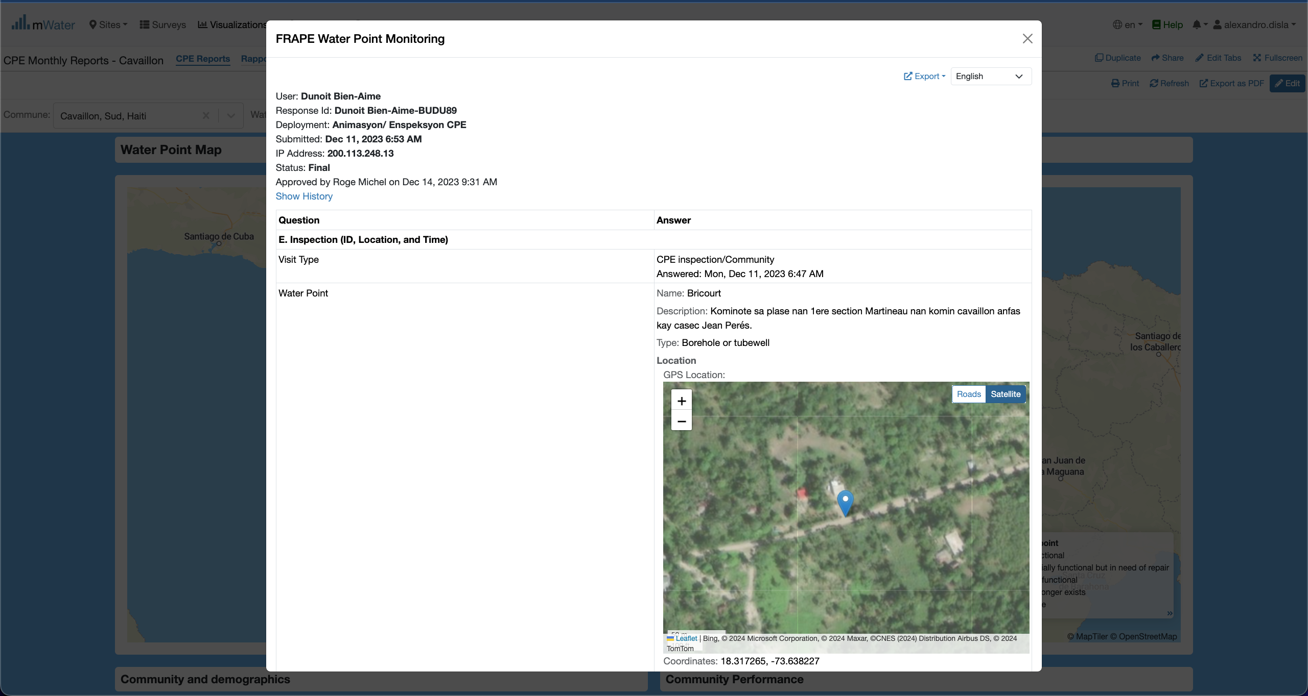
The Map section
Here is the modal response. This will show the report registered for the water point.

Slide 21
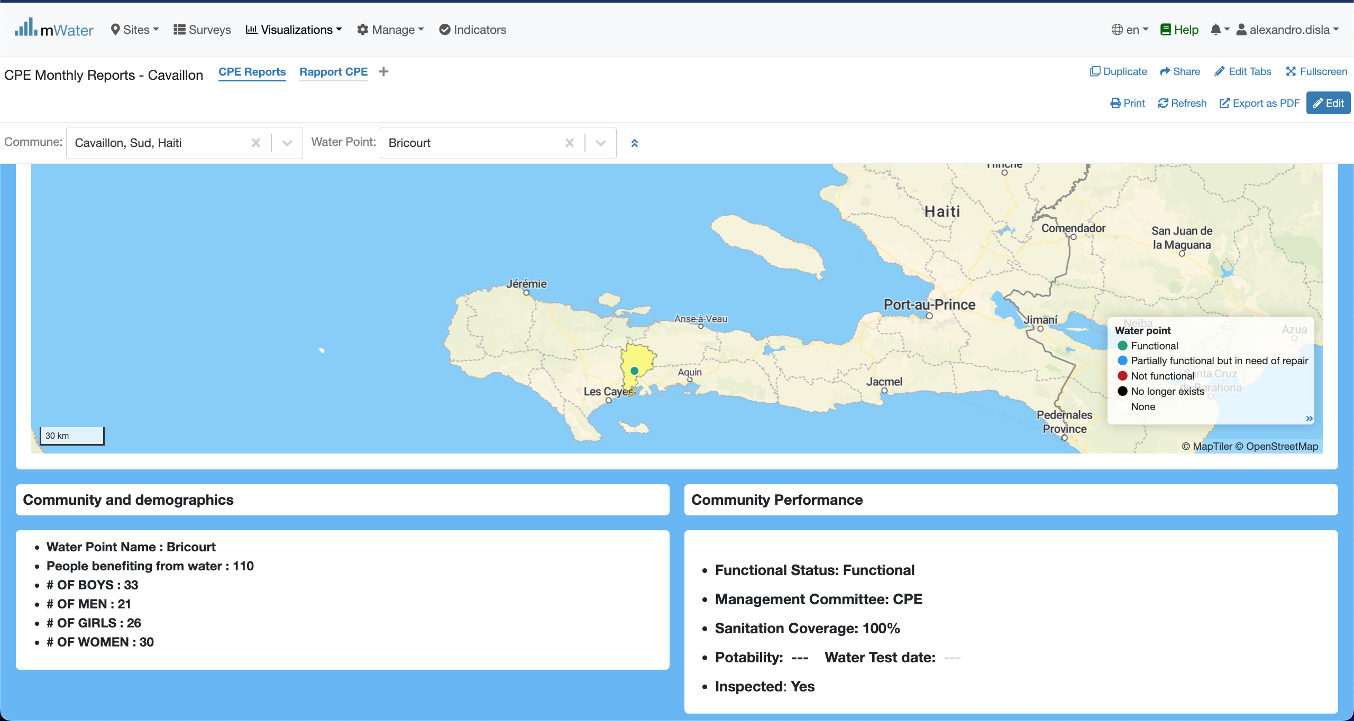
Community section
This section has two components: 1. with demographic information.
2. With the performance informance.

Slide 22
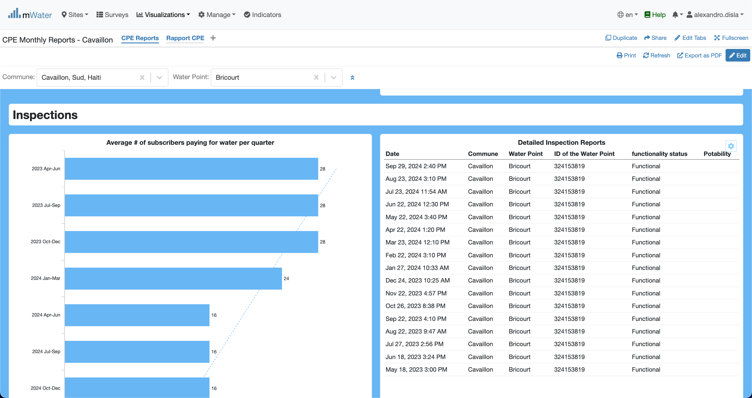
Inspections section
In this table you can see all the inspection reports recorded by the Water Point Committee. Just like the map, you can click on the row to display the report in a modal.
The graphic display the average number of subscribers paying for water for a given quarter.

Slide 23
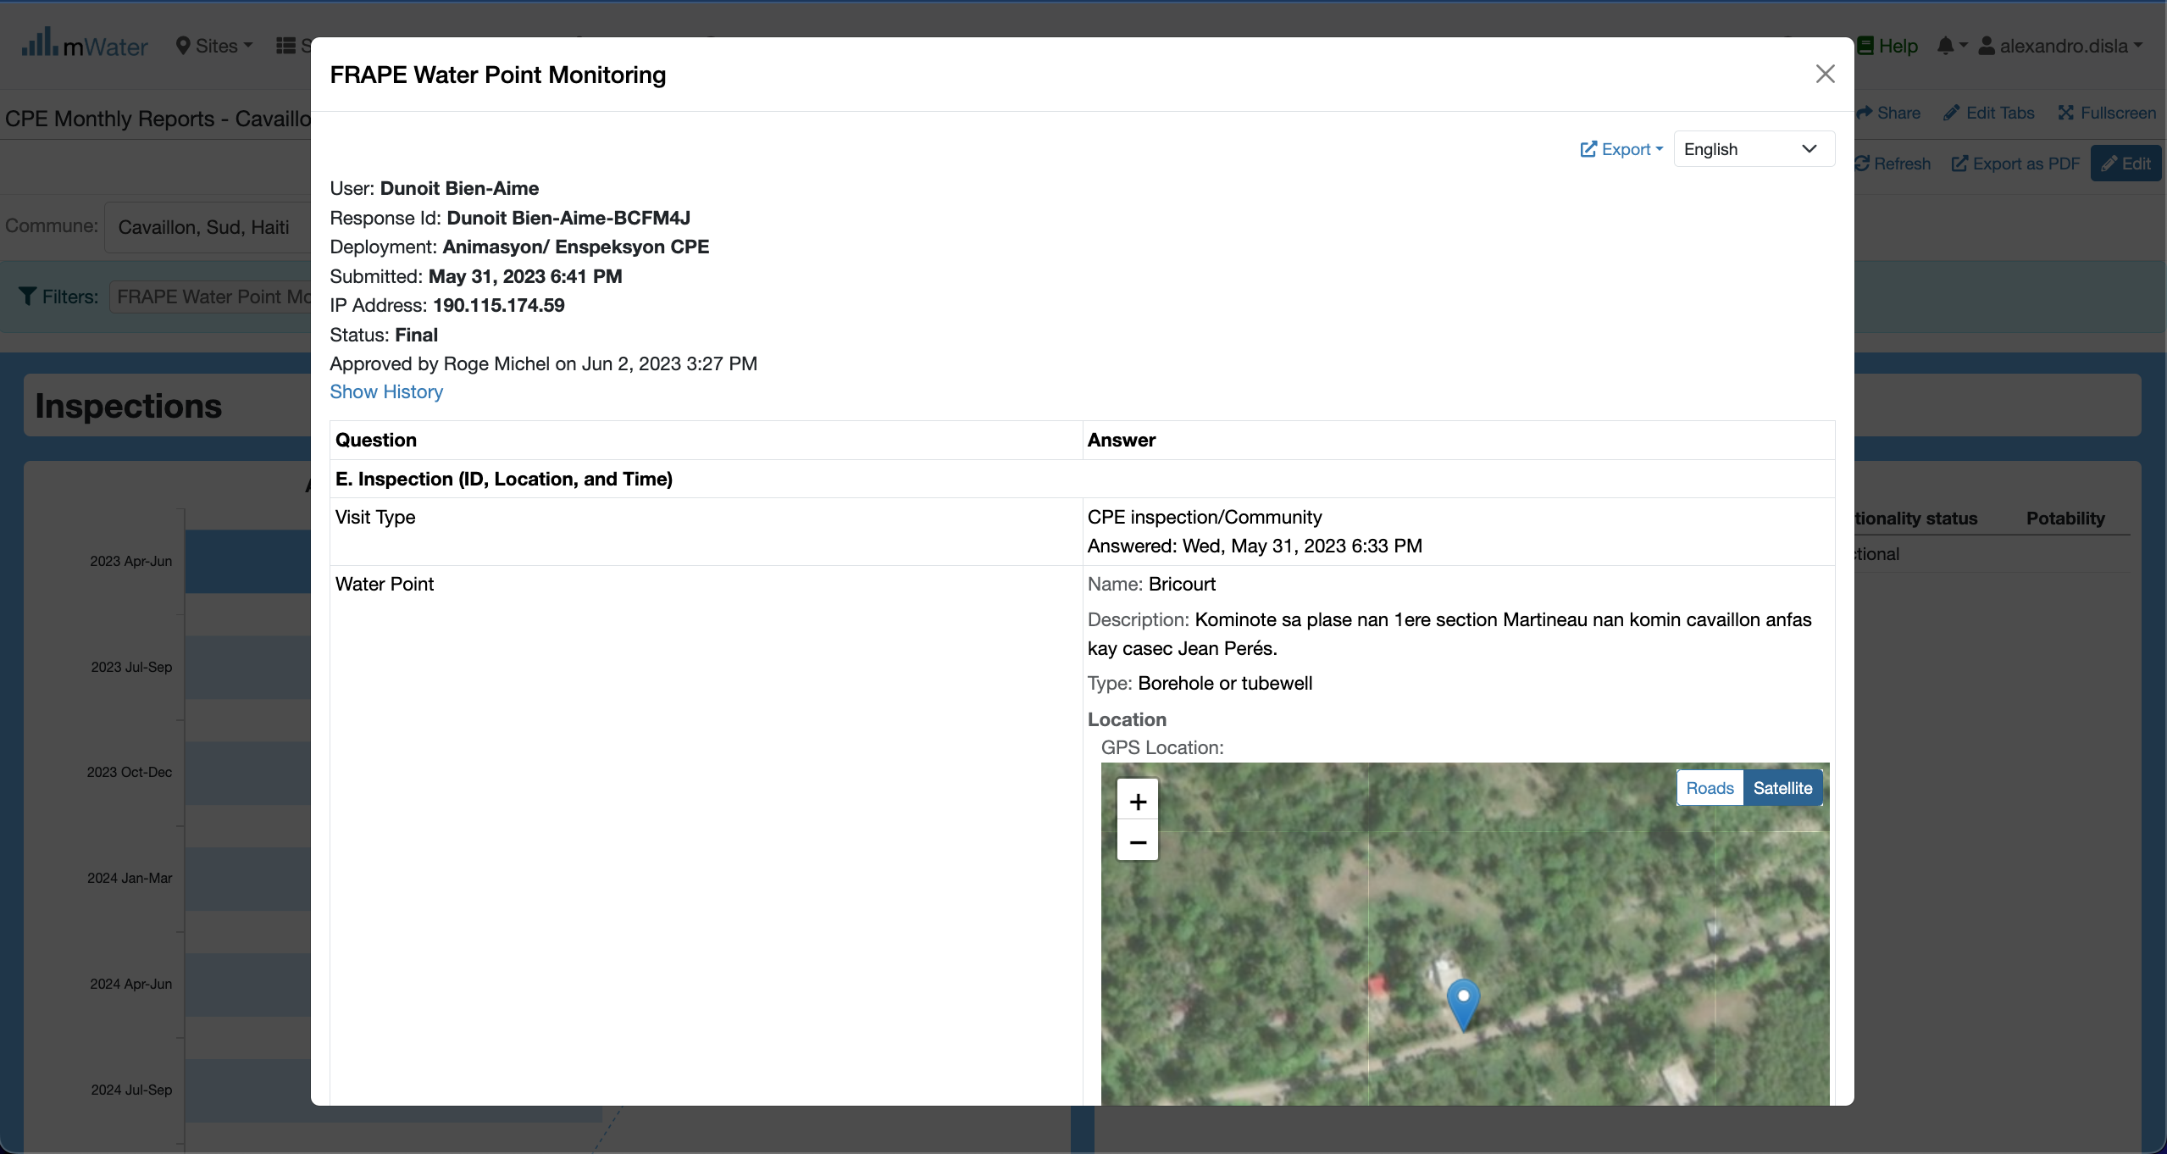
Inspections section
The modal structure is the same. However the actual report is different given the date of the report selected.

Slide 24
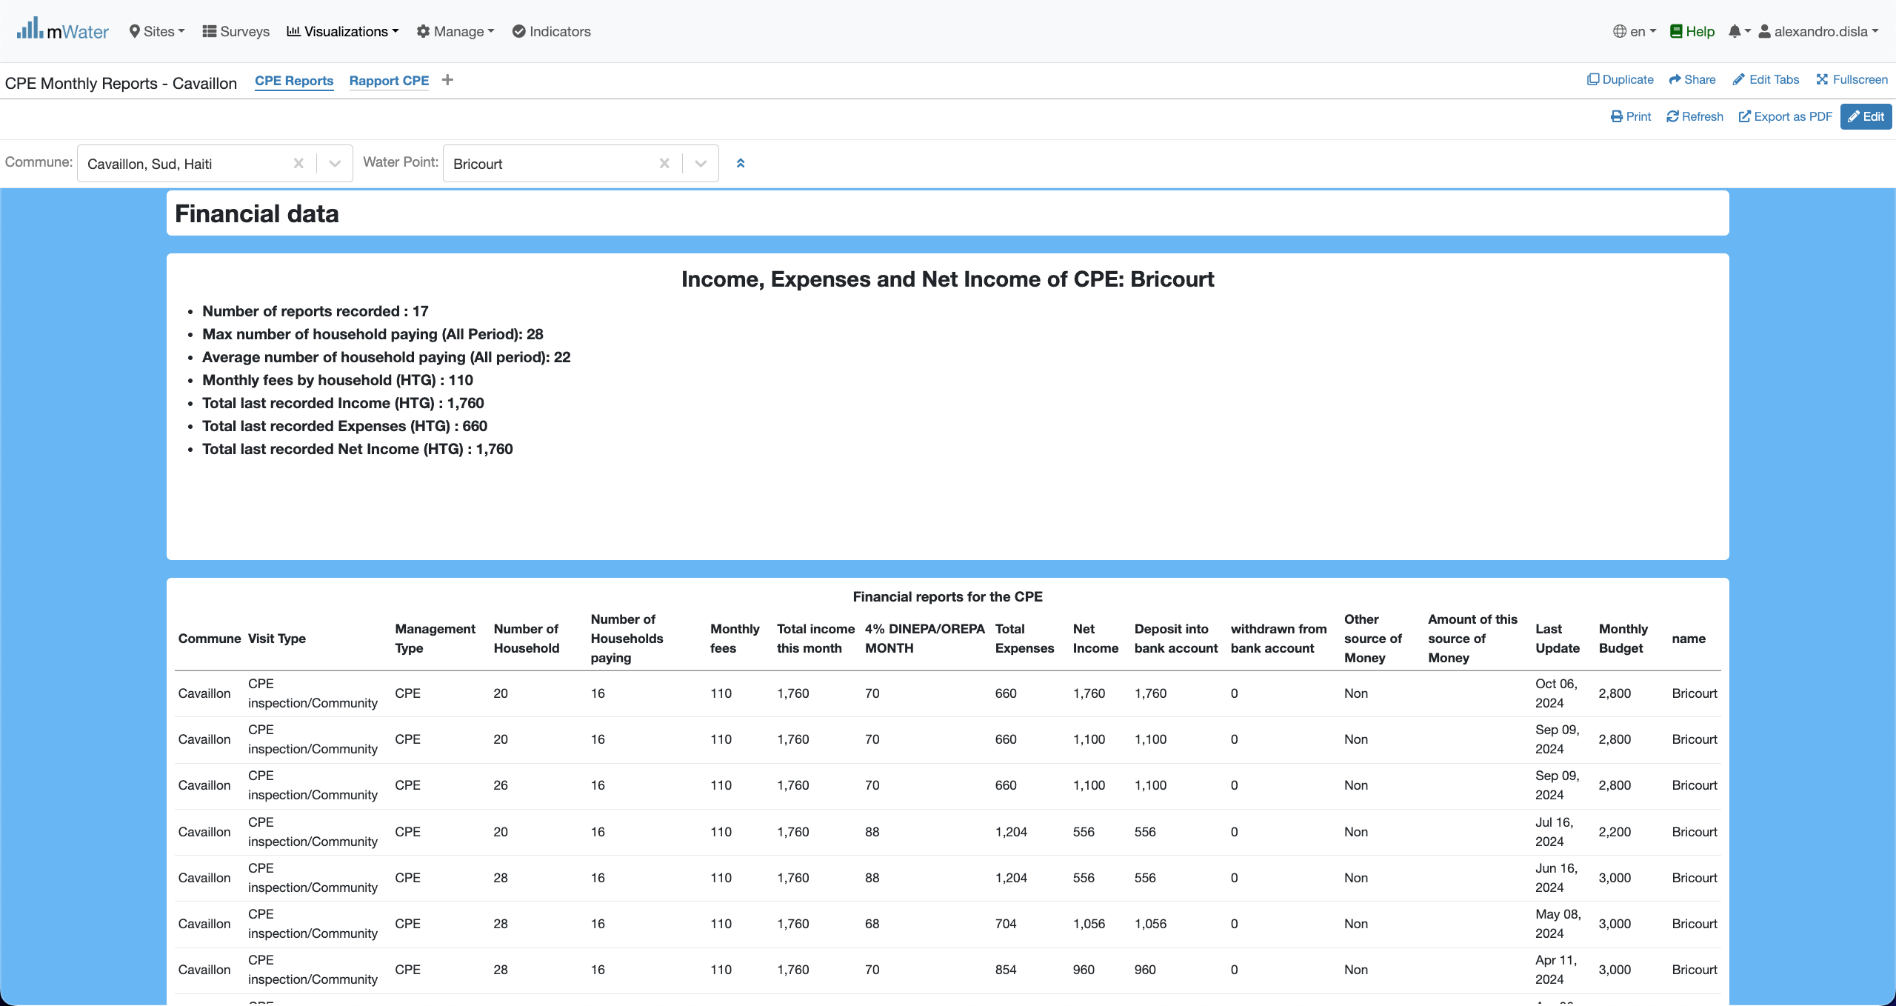
Financial section
These two component below the essantials of the financial information for the Water Point Committee activities.

Slide 25
Export

Slide 26
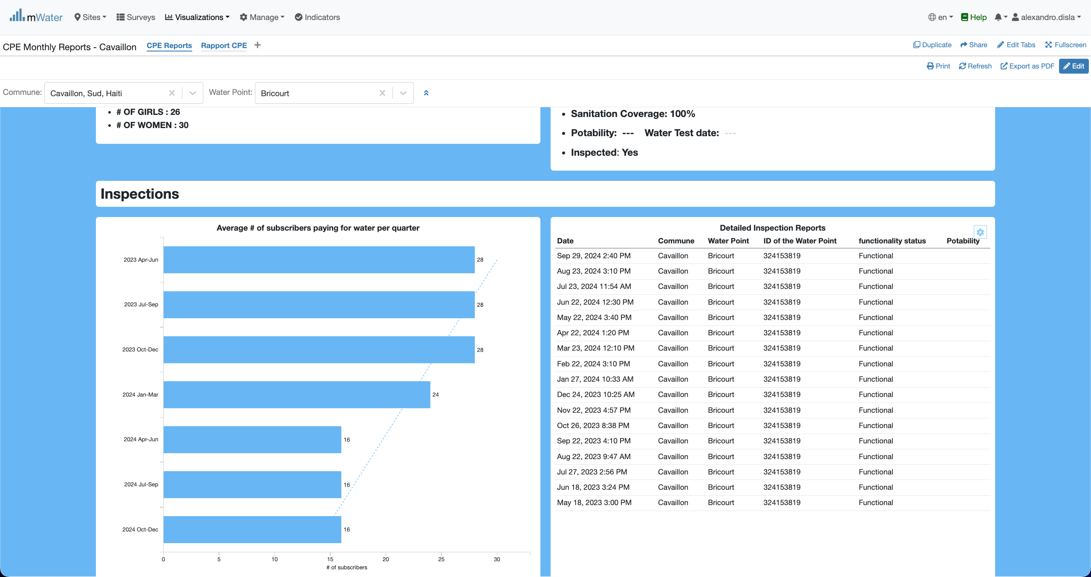
You can export a table
Hover you mouse on the table. The button will appear and you click on it.

Slide 27

You can export a table
Now you can click the export data button to get into the next final step

Slide 28
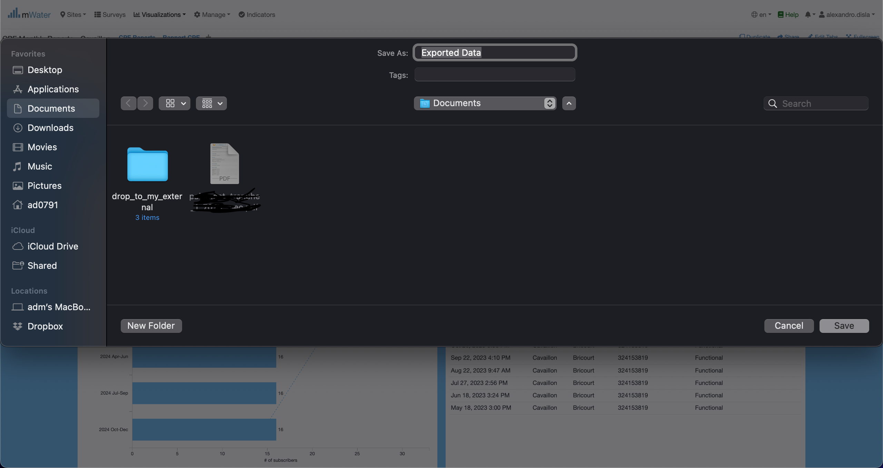
You can export a table
Since I am using a macos. Your interface might be different. You can change the name of the export table as you see fit. After that you can choose to cancel or save the document. By default, in macos it will save the document (spreadsheet) into the Documents folder.

Slide 29
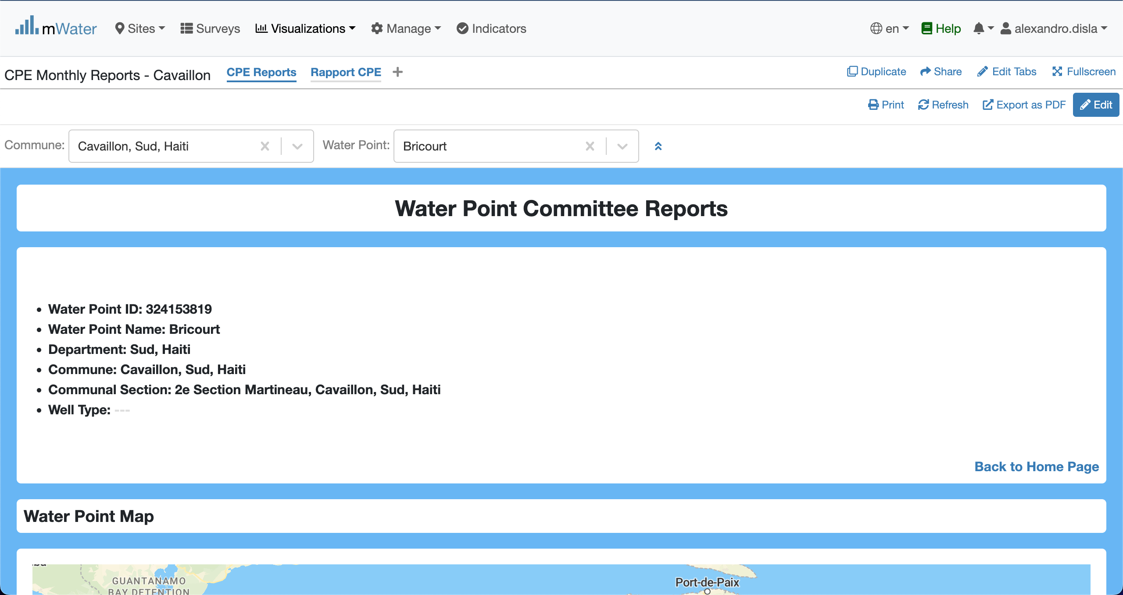
Other export options
The print and the export as pdf are the two standard way to export the results of the console into pdf. However, the export as pdf is recommanded because of his efficiency.
Don’t forget that the quick filters must be active. In order for the console to display the results.

Slide 30
Thank You !!!
PLEASE FEEL FREE TO CONTACT ME BY :
Email / alexandro.disla@hanwash.org
Whatsap or Phone / +50941483700

